Slide 1



The Impact of Marginalization and Intersectionality on Post-Secondary Students with Disabilities’ Use of Assistive Technology: A Scoping Review of the Literature
David I. Pickupª, Eugene F. Borokhovskiª, Christine Vo^{b}, Richard F. Schmidª,
& Catherine S. Fichten^{b}
June 4, 2024, SALTISE Conference, Montreal
ª Center for the Study of Learning and Performance, Concordia University, 1455 De Maisonneuve Blvd. W.,
Montreal, Quebec, Canada, H3G 1M8
^{b} Adaptech Research Network, Dawson College, 3040 Sherbrooke St W, Montreal, Quebec H3Z 1A4
Pickup, D. I., Borokhovski, E. F., Vo, C., Schmid, R. F., & Fichten, C. S. (2024, June 3-4). The impact of marginalization and intersectionality on post-secondary students with disabilities’ use of assistive technology: A scoping review of the literature [Conference presentation]. 13th Annual SALTISE Conference, Montreal, QC, Canada.

Slide 2
About the project
Funded by a SSHRC Knowledge Synthesis Grant to address one of their 16 Global Challenges, Shifting Dynamics of Privilege and Marginalization
The goal was to conduct a scoping review to explore the literature on how the intersection of disability and other identity factors impacted use of assistive technology by post-secondary students.
We built on a previous targeted scoping of the literature on the use of artificial intelligence powered technologies (specifically virtual assistants) by post-secondary students that the team conducted in 2020.

Slide 3
Research Questions
1. Are there intersections of marginalized identity among college students with disabilities that uniquely affect and/or are uniquely affected by using assistive technology (AT)?
2. To what extent do developers of technologies report engaging people with disabilities in design and development (i.e., participatory action research)?
3. What gaps or unaddressed issues exist in the literature on these themes?
4. Are there design features that could mitigate feelings of marginalization?
5. Do specific types of AT privilege certain classes of users more than others?

Slide 4
Methods
Research questions were addressed by means of a systematic scoping review of the available relevant research literature (Arksey & O’Malley, 2005).
To search the literature, we followed the best practices as outlined by the Campbell Collaboration (Kugley et al., 2016)
Following the search, coders (in alternating teams of two) independently implemented both stages of study selection (Title/abstract, and then full-text) by regularly meeting to compare their respective decisions and, when needed, discuss, and resolve disagreements.
These final included studies were then coded for study features and extraction of themes.

Slide 5
Search Strategy
To identify relevant documents, searches were conducted across multiple bibliographic databases in the subject literature (i.e., ERIC, Education Source), related disciplines like Psychology (PsycINFO), Sociology (i.e., Sociological Abstracts, SocINDEX) and major interdisciplinary databases (i.e., Academic Search Complete, Web of Science, ProQuest Central), and Érudit.
Searches employed key terms, and where appropriate database-specific controlled vocabulary, to locate publications on the topic.
Searches were limited to English and French publications between 2010 and 2023 (to focus on current and topical technologies).
Database searches were supplemented by searches of Google Scholar for additional formal publications, and of regular Google for grey literature. We also scanned recent issues of the journals Critical Disability Discourses, Disability Studies Quarterly and the Canadian Journal of Disability Studies for relevant publications.

Slide 6
(disabilit* OR disabl* OR "special need*” OR impair*) AND (marginal* OR stigma* OR minorit* OR positionalit* OR identity OR intersection* OR othering OR exclusion OR inclusion OR isolation OR underclass OR stereotype OR discrimination OR LGBTQ+ OR Gender OR Race OR Black OR "African American" OR Ethnic*) AND ("assistive software" OR "assistive technolog*" OR "artificial intelligence" OR "machine learning" OR "intelligent tutor" OR "smart tutor" OR "virtual assistant" OR “smart assistant” OR "adaptive technolog*" OR "browser extension" OR "Google Assistant" OR Alexa) AND ("adult education" OR "higher education" OR Postsecondary OR University OR College OR Undergraduate OR Tertiary)

Slide 7
Exclusion criteria
The study did not address a disabled/impaired population.
The population was not post-secondary students studying in a formal institution of higher education.
The study did not address either a) intersectionality of identity characteristics, or b) a specific marginalized community.
The study was focused on intellectual disability.
The study did not address the use of AT (it did not need to be the primary focus but had to play a significant role, and outcomes could vary – whether it was impact on achievement, willingness to use technology, feelings of stigma, etc.);
The study was not conducted in North America; we decided early on to limit ourselves geographically to focus on informing educational practice most relevant to the Canadian context, as the proposal and team resources were not designed to analyze the multitude of international contexts.

Slide 8
Results
A total of 1,241 results were obtained by searches, which were added to an existing database of 305 records in a collection gathered for a prior review of AI-based virtual assistants for post-secondary students with disabilities (see Fichten et al., 2021), which brought the total to 1,546 records.
After removing duplicates, a collection of 1,136 records was left to undergo abstract screening.
151 results were coded for full-text review, of which 146 were obtained and reviewed
12 publications were included in the final review (three dissertations, two book chapters, one conference paper, and five journal articles)

Slide 9
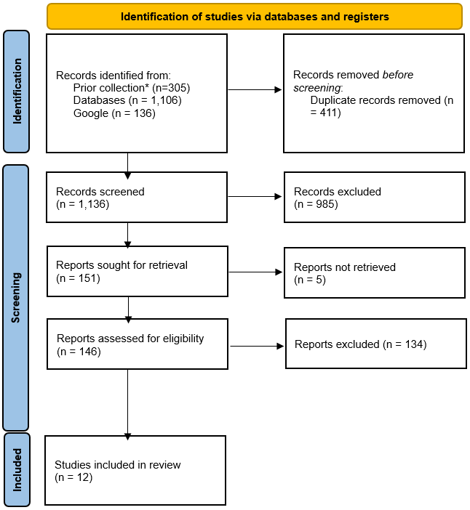

Slide 10
Results
8 studies addressed intersectionality
3 discussed elements of marginalization and/or privilege
6 studies had themes of stigma associated with disability
Gender was the most frequently considered identity factor (7 of 12 studies)
Race or cultural background was considered in 5
Other identity intersections that appeared were socio-economic status (1) and age (2)

Slide 11
Results
We found no studies where participatory action research was employed to engage students with disabilities in the design of tools.
Few publications discussing the intersection of disability with other identity factors were focused on how it impacts use or choice of AT for post-secondary students, evincing a gap in the literature to be addressed.
Most publications discussed AT broadly, and with various examples, without focusing on any specific technology.
Most publications also treated disability broadly rather than focusing on students with specific issues. Visual disabilities appeared most frequently.

Slide 12
Disabilities within the included studies
Disability | Frequency count
Visual impairment | 10
Limited mobility | 10
Learning disability | 6
Hearing impairment | 4
Autism | 3
ADHD | 2
Mental health difficulty | 2
Brain injury | 2
Limited use of hands | 1

Slide 13
AT types within included studies
Assistive technology | Frequency count
Text-to-speech | 10
Smartphone apps | 10
Notetakers | 3
Audio recording | 3
Virtual assistants | 2
Captions | 2
Sensory aids | 2
Courseware | 2
Alternative keyboards | 2
Facial recognition | 1
Eye tracking | 1
Magnification | 1
Tactile support | 1
Scanners | 1

Slide 14
Key findings
How the intersectionality of disability with other identity factors affects use of AT by post-secondary students remains an under-researched topic.
AT can reinforce and magnify feelings of marginalization. However, carefully implemented it can be liberating and provide more independence.
Cultural acceptance of both disability and AT can vary, for example in one study first generation immigrant populations reported AT drawing unwanted attention to a disability.
Authors argued that understanding the intersectionality of factors such as socioeconomic status, cultural background, and geographical location is pivotal in developing comprehensive support systems
Trends in digital design emphasized that socially constructed features from the analog world are migrated to the digital environments; Universal Design for Learning suggested.

Slide 15
Implications
Developers of AT tools, as well as university accessibility specialists should keep in mind that students from different cultural and socio-economic backgrounds may face additional and unique challenges and obstacles.
A continued shift towards Universal Design for Learning in online education and AT development should be prioritized to ensure equitable access to higher education for all students is “built in”.
There is a lack of participatory action research in this area. Students with disabilities from a diversity of backgrounds should be consulted more regularly and included in the development team when AT is produced.
There is a lack of research on the impact of the intersection of disability with other identity factors on the use of AT by students.
Research in this area continues to focus on university access services/offices; however, students increasingly use their own AT (e.g. through apps on their phone), so greater attention in the research should be paid to specific tools and applications.

Slide 16
Thank you.
Follow up questions may be sent to:
David Pickup, MLIS, Information specialist, Concordia University: david.pickup@concordia.ca
Catherine Fichten, PhD, Professor, Department of Psychology, Dawson College: cfichten@dawsoncollege.qc.ca

