Slide 1
10 EASY Things You Can Do to Make Your Course More Accessible to Students With Disabilities
Alice Havel, Catherine Fichten, Mary Jorgensen,
Adaptech Research Network
Intercollegiate Ped Days
January 12th, 2022

Slide 2
Who Are We?
The Adaptech Research Network is
Team of teachers, professionals, students, researchers
Conduct research on post-secondary students with and without disabilities
Focus on technologies
Based at Dawson College

Slide 3
Who Are You?
Teacher
Access service provider
Administrator
Pedagogical Counsellor
Other

Slide 4
From Which College?
Champlain
Dawson
Heritage
John Abbott
Marianopolis
Vanier
Other

Slide 5
What Motivated You To Register?
Please put your response in the chat

Slide 6
Our Goals For the Session
Share things that can help make a course accessible
Provide instructions on how to do these things
Encourage you to exchange information

Slide 7
Sources of Our Information
Research findings – ours and other researchers’
Questionnaires, focus groups, and interviews
Students
Faculty
Professionals
E-Access Concordia Project
COVID-19 practices

Slide 8
Who Are the Students In Our Research?
15 to 20% of students self-reported a disability
50% had multiple disabilities
50% were not registered with accessibility services
Two most frequent disabilities reported
Mental health issues
Learning disabilities (LD) / attention deficit hyperactivity disorder (ADHD)

Slide 9
Thing # 1: Communicate Constructively
Invite students to indicate accessibility needs
In class
On course outline
Use only one learning management system
E.g., Lea, Moodle
Use multiple formats to convey ideas
E.g., text, audio, video, diagrams
Repeat students’ questions

Slide 10
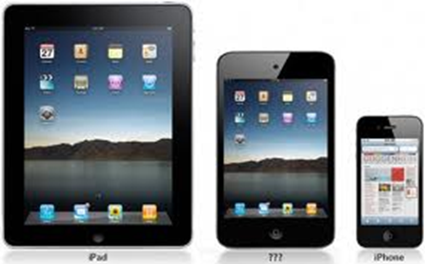
Thing # 2: Allow Use of Personal Tech In Class
Students like to use their personal tech in class
Set clear guidelines
Students need personal tech to
Take class notes
Read instructions or textbook
Take photos of board or screen
Organize self
Get help

Slide 11
Thing # 3: Use Tech in Teaching
Use technology
That has a purpose
Functions well
Students like
Online posting of PowerPoints, readings, grades, videos of lectures
Polling, online quizzes, PPT fill in the blank
Online assignment submission

Slide 12
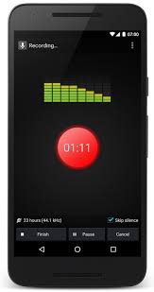
Thing # 4: Support Students in Use of Tech
Provide instructions on how to
Navigate course management system
Use required software
Encourage use of assistive technology
Built into general use technology
Dictation in Microsoft 365
Narration (text-to-speech)
Apps to help with
Reading
Writing
Time management

Slide 13
Thing # 5: Make Sure Formats Are Accessible (1)
Cannot assume that digital = accessible
Why format is important
To access screen readers, text-to-speech, apps
To change font, text size, spacing, colour
To add notations

Slide 14
Thing # 5: Make Sure Formats Are Accessible (2)
Types of files that are generally accessible
PowerPoint
Word
EPUB
Most accessible for textbooks
If you want to convert a Word or PPT document to PDF
SAVE to PDF
Do not PRINT to PDF

Slide 15
Thing # 5: Make Sure Formats Are Accessible (3)
Excel not always accessible
Add alt text to table or graph
Label all cells in first row and column
Row 1 | Name | Phone number | Email
Row 2 | Jane Doe | 555-123-4567 | Jane.Doe@gmail.com
Row 3 | John Smith | 555-456-7123 | John.Smith@outlook.com

Slide 16
Thing # 5: Make Sure Formats Are Accessible (4)
Make course packs accessible
No underlining or handwriting
No shaded background
No missing or light text
No content cut off at edges
No partial pages visible on side
https://www.uvic.ca/services/cal/courses/course-materials/coursespaces-material/index.php

Slide 17
Thing # 6: Make PowerPoints Accessible
Use sans serif font, such as Arial or Calibri
Use minimum 24 pt. font
Use high contrast between text and background
Avoid distracting background images

Slide 18
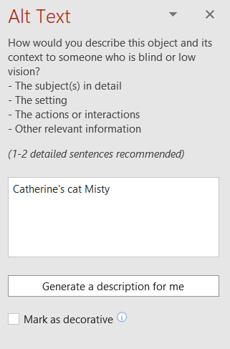
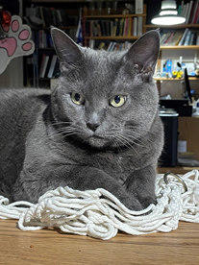
Thing # 7: Provide Alt Text
Add alt text to all images, graphs, and tables
Word
PowerPoint
Excel

Slide 19
Thing # 8: Caption Videos (1)
Convert audio content into subtitles
Automatic captions generated by AI
Available on Zoom and Teams
Can be turned on and off
May require editing (craptions)
Unedited captions are better than nothing

Slide 20
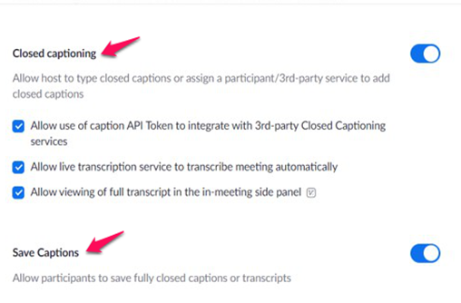
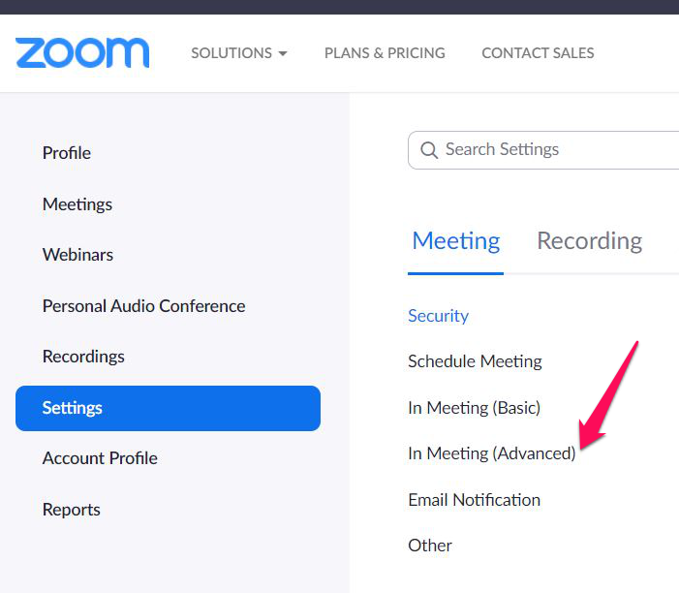
Thing # 8: Caption Videos (2)
Create Zoom Automatic Captions
Log into your Zoom account

Slide 21
Thing # 9: Prepare Accessible Assignments & Evaluations (1)
For assignments
Allow for flexibility in the due dates (slip day)
For tests and exams
Allow all students extended time on tests
Unless speed is an essential competency
Option to justify answers
E.g., for multiple choice/true-and-false questions

Slide 22
Thing # 9: Prepare Accessible Assignments & Evaluations (2)
To allow a student extended time on a Moodle quiz
Click the Gear icon
Choose “User overrides”
Click “Add user override”
Click the down arrow to scroll to the appropriate student

Slide 23
Thing # 10: Be Aware of Mental Health Issues
44% of students reported feeling depressed ¹
Provide flexibility around deadlines
Offer alternatives to oral presentations
Don’t make all students talk in class
Distinguish roles of teacher and therapist
¹https://bp-net.ca/wp-content/uploads/2019/04/2018_Breaking-Down-Barriers-Mental-Health-and-Canadian-Post-Secondary-Students_CASA.pdf

Slide 24
What Do You Think?
We want to hear your:
(1) Opinions
(2) Experiences
(3) Questions

Slide 25
Resources
MOOC: Basics of Inclusive Design for Online Education https://www.coursera.org/learn/inclusive-design
E-Access Concordia Project https://adaptech.org/research/e-access-concordia-project/
Adaptech Research Network: www.adaptech.org
Alice Havel: ahavel@dawsoncollege.qc.ca
Catherine Fichten: catherine.fichten@mcgill.ca
Mary Jorgensen: mjorgensen@dawsoncollege.qc.ca

