Slide 1



Inclusive design: Making face-to-face and online courses accessible to ALL students, with and without disabilities.
Catherine Fichten & Anick Legault
In collaboration with
Mary Jorgensen, Alice Havel, Maegan Harvison, & Christine Vo
Adaptech Research Network and Dawson College
Webinar for CSLP
November 26, 2020

Slide 2
Presentation Objectives
Accessibility and post-secondary education
Inclusion: UDL enables engagement and motivation
Solving access problems
COVID-19: Impact on learning
Why bother with accessibility?

Slide 3

Who are we?
  Polling activity
    Get your cellphones out or
    Open a new tab in your web browser!
Notes:
Question 1: In your opinion, should people with disabilities be enrolled in Cégep and university?
Choices:
Yes
No
Unsure
Question 2: In your opinion, what percentage of Cégep and university students have a disability?
Choices:
0-5%
6-10%
11-20%
21-50%
Question 3: In your opinion, if you can only choose one option, whose job is it to make educational materials accessible to students with disabilities?
Choices:
Parents
Accessibility services (Cégep/university)
Professor
Student
Other

Slide 4

Invisible Disabilities

Slide 5
Accessibility and Post-Secondary Education
10% to 20% of your students have a disability¹
Study: n=1387 Cégep students²
  241 (17%) "self-reported" a disability
    LD / ADHD
    Mental Health Problems
    Chronic health problems
    Deafness, hearing and visual impairments
  ALL your students must be able to
    Read and understand your course materials
¹ Eagan, M. K., Stolzenberg, E. B., Zimmerman, H. B., Aragon, M. C., Whang Sayson, H. et Rios-Aguilar, C. (2017). The American freshman: National norms fall 2016. Higher Education Research Institute. https://www.heri.ucla.edu/monographs/TheAmericanFreshman2016.pdf
² Fichten, C.S., Havel, A., King, L., Jorgensen, M., Budd, J., Asuncion, J., Nguyen, M.N., Amsel, R. et Marcil, E. (2018). Are you in or out? Canadian students who register for disability-related services in junior/community colleges versus those who do not. Journal of Education and Human Development, 7(1), 166-175. DOI: 10.15640/jehd.v7n1a19
Notes:
1 Eagan, M. K., Stolzenberg, E. B., Zimmerman, H. B., Aragon, M. C., Whang Sayson, H. et Rios-Aguilar, C. (2017). The American freshman: National norms fall 2016. Higher Education Research Institute. https://www.heri.ucla.edu/monographs/TheAmericanFreshman2016.pdf
2 Fichten, C.S., Havel, A., King, L., Jorgensen, M., Budd, J., Asuncion, J., Nguyen, M.N., Amsel, R. et Marcil, E. (2018). Are you in or out? Canadian students who register for disability-related services in junior/community colleges versus those who do not. Journal of Education and Human Development, 7(1), 166-175. DOI: 10.15640/jehd.v7n1a19

Slide 6
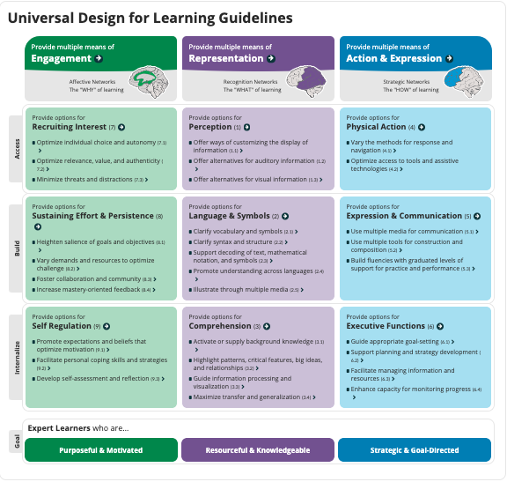
UDL Enables Commitment and Motivation
Overview of Universal Design of Learning (UDL)
http://udlguidelines.cast.org/
Capp, M.J. (2017). The effectiveness of universal design for learning: A meta-analysis of literature between 2013 and 2016. International Journal of Inclusive
Education (21)8, 791-807. DOI: 10.1080/13603116.2017.1325074
CAST (2018). Universal Design for Learning Guidelines version 2.2. Retrieved from http://udlguidelines.cast.org
Notes:
Capp, M.J. (2017). The effectiveness of universal design for learning: A meta-analysis of literature between 2013 and 2016. International Journal of Inclusive
Education (21)8, 791-807. DOI: 10.1080/13603116.2017.1325074
CAST (2018). Universal Design for Learning Guidelines version 2.2. Retrieved from http://udlguidelines.cast.org

Slide 7
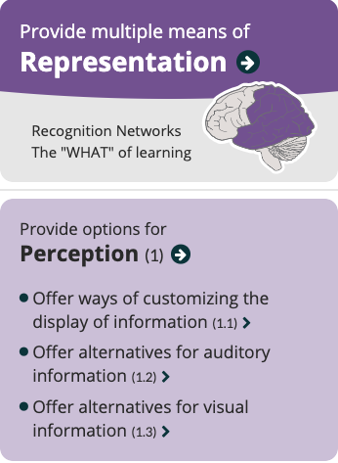
UDL Enables Commitment & Motivation
Alternatives for
  Auditory
  Visual information
CAST (2018). Universal Design for Learning Guidelines version 2.2. Retrieved from http://udlguidelines.cast.org
Notes:
CAST (2018). Universal Design for Learning Guidelines version 2.2. Retrieved from http://udlguidelines.cast.org

Slide 8
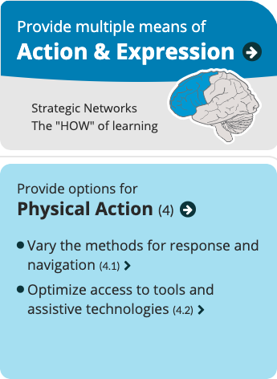
UDL Enables Commitment & Motivation
Optimize access to tools & assistive technologies
CAST (2018). Universal Design for Learning Guidelines version 2.2. Retrieved from http://udlguidelines.cast.org
Notes:
CAST (2018). Universal Design for Learning Guidelines version 2.2. Retrieved from http://udlguidelines.cast.org

Slide 9
Solving Access Problems
Excellent free short videos
  ¹ Basics for Inclusive Design for Online Education
    Free MOOC from Coursera
    Watch videos when you need them:
      Week 2 : Accessible documents (Word, PDF, PPTX)
      Week 3 : Complex Images, Tables, Graphs (alt text)
      Week 4 : Captioning (YouTube and other videos)
¹ https://www.coursera.org/learn/inclusive-design
Notes:
https://www.coursera.org/learn/inclusive-design

Slide 10
Solving Access Problems
PowerPoints
  ¹The Do’s and Don’ts: The UD Perspective
  ²The students' viewpoint: six easy fixes
  ³Researching Best Presentation Practices
Course Packs
  Use new material - not photocopies
    No underlining
    No highlighting
    No annotation in the margin
¹https://adaptech.org/wp-content/uploads/Marcil_SALTISE_final.pptx
²https://adaptech.org/wp-content/uploads/abPsychBulletin.pdf
³http://www.profweb.ca/en/publications/articles/researching-best-presentation-practices-and-sharing-of-powerpoints
Notes:
1https://adaptech.org/wp-content/uploads/Marcil_SALTISE_final.pptx
2https://adaptech.org/wp-content/uploads/abPsychBulletin.pdf
3http://www.profweb.ca/en/publications/articles/researching-best-presentation-practices-and-sharing-of-powerpoints

Slide 11

Solving Access Problems
Course Captioning
PPTX – built-in function (“craptions”)
    Zoom
    Webex
    Team
    Stream – interactive textbox
    YouTube

Slide 12

COVID-19: Impact on Learning
  Scientific literature review
  Chat / blog / forums
  Surveys
    Dawson: 2 student surveys
    Other institutions
      Concordia - ongoing
      Other institutions?

Slide 13
COVID-19: Impact on Learning
  Limited scientific information. Therefore
    We have some Covid grants
      PIA, S051, FRQSC
      Brand new grant (SSHRC)
    Waiting for other grants (Volkswagen Foundation)
    Just applied
      Knowledge synthesis (FRQSC)
      Ministère de l’Économie et de l’Innovation (MEI)
Notes:
Le Pôle montréalais d’enseignement supérieur en intelligence artificielle

Slide 14

Why Bother with Accessibility?
Study results¹
  Students with and without disabilities
    Grades = equal
    Graduation rate = equal
    Employment rate = equal
¹ Jorgensen, S., Fichten, C.S., Havel, A., Lamb, D., James, C. et Barile, M. (2005). Academic performance of college students with and without disabilities: An archival study. Canadian Journal of Counselling, 39(2), 101-117.
Notes:
1 Jorgensen, S., Fichten, C.S., Havel, A., Lamb, D., James, C. et Barile, M. (2005). Academic performance of college students with and without disabilities: An archival study. Canadian Journal of Counselling, 39(2), 101-117.

Slide 15

Grades
12-year archival Cegep study¹
Program | Learning disabilities / ADHD |  |  | All other disabilities |  |  | No disability
 | n | Grade |  | n | Grade |  | n | Grade
Social sciences | 166 | 64% |  | 103 | 70% |  | 13,908 | 62%
Career/ technical | 32 | 64% |  | 40 | 71% |  | 4,634 | 67%
All programs | 347 | 64% |  | 285 | 70% |  | 40,262 | 66%
¹ Jorgensen, S., Fichten, C.S., Havel, A., Lamb, D., James, C. et Barile, M. (2005). Academic performance of college students with and without disabilities: An archival study. Canadian Journal of Counselling, 39(2), 101-117.
Notes:
1 Jorgensen, S., Fichten, C.S., Havel, A., Lamb, D., James, C. et Barile, M. (2005). Academic performance of college students with and without disabilities: An archival study. Canadian Journal of Counselling, 39(2), 101-117.

Slide 16

Graduation and Perseverance
Students with and without disabilities graduate at the same rate¹
  The graduation rate for students with disabilities is actually higher
    Not significantly
  Take an extra semester
¹ Jorgensen, S., Fichten, C.S., Havel, A., Lamb, D., James, C. et Barile, M. (2005). Academic performance of college students with and without disabilities: An archival study. Canadian Journal of Counselling, 39(2), 101-117.
Notes:
1 Jorgensen, S., Fichten, C.S., Havel, A., Lamb, D., James, C. et Barile, M. (2005). Academic performance of college students with and without disabilities: An archival study. Canadian Journal of Counselling, 39(2), 101-117.

Slide 17
Graduation and Perseverance
Jorgensen, S., Fichten, C.S., Havel, A., Lamb, D., James, C. et Barile, M. (2005). Academic performance of college students with and without disabilities: An archival study. Canadian Journal of Counselling, 39(2), 101-117.

Slide 18
Employment
  Graduates of 3 colleges 5-10 months after graduation¹
 |  | n |  | Work full-time | Work part-time | Looking for a job | Student | Not available for work
Pre-university
 | With disability | 90 |  | 10% | 4% | 1% | 83% | 1%
 | No disability | 752 |  | 8% | 5% | 2% | 84% | 2%
Career / technical
 | With disability | 86 |  | 51% | 15% | 1% | 30% | 2%
 | No disability | 540 |  | 49% | 14% | 3% | 31% | 3%
¹ Fichten, C.S., Jorgensen, S., Havel, A., Barile, M., Ferraro, V., Landry, M-E., Fiset, D., Juhel, J-C., Chwojka, C., Nguyen, M.N., Amsel, R. et Asuncion, J.V. (2012). What happens after graduation? Outcomes, employment, and recommendations of recent junior/community college graduates with and without disabilities. Disability and Rehabilitation 34(11), 917-924.
Notes:
Employed
Pre-university
14% with a disability
13% nondisabled
Career/technical
66% with a disability
63% nondisabled

Slide 19
Employment: 4 Years Later
  ¹Study n = 175 university students, 77 Cégep students
  4 years later
    193 graduated from original program
    59 dropped out. Some
      Switched to another program,
      Another post-secondary institution
  Employment
    9% not in the workforce
    Among those in the workforce
      82% are employed
    Jobs (graduates) closely related to field of study
¹ Fichten, C., Amsel, R., Jorgensen, M., Nguyen, M. N., Budd, J., Havel, A., King, L., Jorgensen, S., & Asuncion, J. (2016).Theory of Planned Behavior: Sensitivity and specificity in predicting graduation and drop-out among college and university students? International Journal of Learning, Teaching and Educational Research, 15(7), 38-52. Retrieved from http://ijlter.org/index.php/ijlter/article/view/694/pdf
Notes:
1Fichten, C. S., Jorgensen, S., Havel, A., Barile, M., Ferraro, V., Landry, M.-E., Fiset, D., Juhel, J.-C., Chwojka, C., Nguyen, M. N. et Asuncion, J. V. (2012). What happens after graduation? Outcomes, employment, and recommendations of recent junior/community college graduates with and without disabilities. Disability and Rehabilitation, 34(11), 917-924.

Slide 20
References
Eagan, M. K., Stolzenberg, E. B., Zimmerman, H. B., Aragon, M. C., Whang Sayson, H. & Rios-Aguilar, C. (2017). The American freshman: National norms fall 2016. Higher Education Research Institute. https://www.heri.ucla.edu/monographs/TheAmericanFreshman2016.pdf
Capp, M.J. (2017). The effectiveness of universal design for learning: A meta-analysis of literature between 2013 and 2016. International Journal of Inclusive Education (21)8, 791-807. DOI: 10.1080/13603116.2017.1325074
Fichten, C., Amsel, R., Jorgensen, M., Nguyen, M. N., Budd, J., Havel, A., King, L., Jorgensen, S., & Asuncion, J. (2016).Theory of Planned Behavior: Sensitivity and specificity in predicting graduation and drop-out among college and university students? International Journal of Learning, Teaching and Educational Research, 15(7), 38-52. Retrieved from http://ijlter.org/index.php/ijlter/article/view/694/pdf
Fichten, C. S., Havel, A., King, L., Jorgensen, M., Budd, J., Asuncion, J., Nguyen, M. N., Amsel, R. & Marcil, E. (2018). Are you in or out? Canadian students who register for disability-related services in junior/community colleges versus those who do not. Journal of Education and Human Development, 7(1), 166-175. DOI: 10.15640/jehd.v7n1a19
Fichten, C. S., Jorgensen, S., Havel, A., Barile, M., Ferraro, V., Landry, M.-E., Fiset, D., Juhel, J.-C., Chwojka, C., Nguyen, M. N., Amsel, R. & Asuncion, J.V. (2012). What happens after graduation? Outcomes, employment, and recommendations of recent junior/community college graduates with and without disabilities. Disability and Rehabilitation 34(11), 917-924.
Jorgensen, S., Fichten, C. S., Havel, A., Lamb, D., James, C. & Barile, M. (2005). Academic performance of college students with and without disabilities: An archival study. Canadian Journal of Counselling, 39(2), 101-117.

Slide 21


Thank You! Questions?
Adaptech Research Network: www.adaptech.org
Catherine Fichten: catherine.fichten@mcgill.ca
Anick Legault: aclegault@dawsoncollege.qc.ca

